Slide 1
Annual Product Category Quality Analysis
Overview :
Business performance in eCommerce is closely related to the products available within it. Analyzing the quality of products in eCommerce can provide insights for making better business decisions. Product quality is important because it
influences a company's success and helps build its reputation in the customer market. When a company can create
high-quality products that continuously meet customer demands, it can result in a higher return on investment and
increased revenue. In this section, we will conduct an Annual Product Category Quality Analysis by analyzing annual business metrics related to revenue and canceled orders.
Here is the summary table of total revenue, total cancel orders, top product category revenue, and top product category cancel order performance :
The full query can be found here

Slide 2
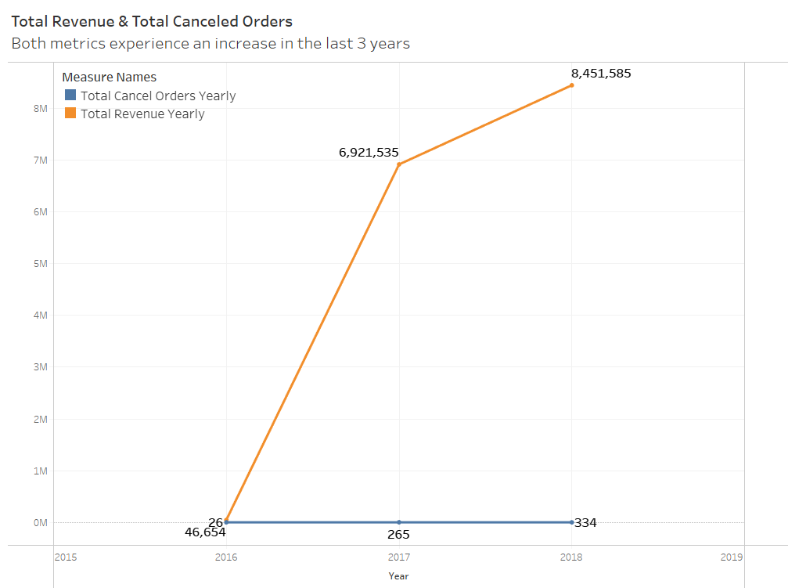
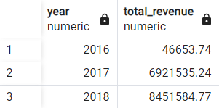
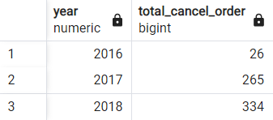
Annual Product Category Quality Analysis
1. Total revenue per year
Create a table that contains total company revenue information for each year
2. Total cancel order per year
Create a table that contains information on the total number of canceled orders for each year
Insight :
Increase in revenue (significantly in 2017) typically suggests that the business is growing and attracting more new customers, leading to higher sales volumes. It could be due to various factors such as effective marketing strategies, great product quality, or increased market demand.
Small increase in canceled orders could indicates potential issues within the business like inaccurate product descriptions, shipping delays on some products, inventory management issues on some sellers, or customer service problems in the platform.

Slide 3
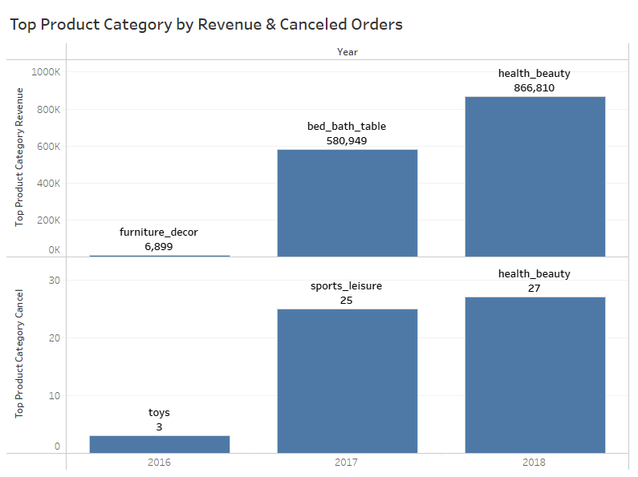
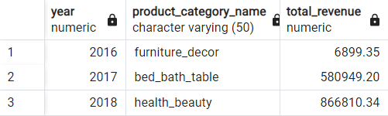
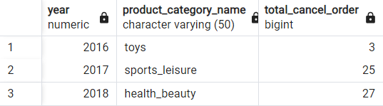
Annual Product Category Quality Analysis
3. Top product category by revenue per year
Create a table containing the product category names that provide the highest total revenue for each year
4. Top product category by cancel order per year
Create a table containing the names of the product categories that have the highest number of canceled orders for each year
Insight :
The types of product categories, both for top revenue and top canceled orders, all have different types each year. This suggest an evolving in consumer preferences and market demand fluctuations which could be influenced by seasonal trends, economic factors, or other external influences. In 2018, health_beauty became the top product category by revenue and cancel order is the example of this where there could potentially an important events.
There is also the need to analyze further related to the products canceled, to gain the reason behind it. Whether it is related to the price, supply chain and inventory management issues, or something else.

